Slide 1
Project Presentation of Exploratory Project (EP)
On
AIRLINE RESERVATION SYSTEM
Yashika Taneja(2210990979)
Saniya Ahuja(2210990787)
Upinder Kaur(2210990927)
SUPERVISED BY :
Ms.Roshni Mali
Department of Computer Science & Engineering
Chitkara University, Punjab

Slide 2


Introduction
The Airline Reservation System’s main aim is to provide online ticket and seat reservation services for national and International Flights, as well as to provide information about flight departures.
It helps with flight tickets.
This project will also cover adding, deleting or modifying the customer details and flights. In general, this website would be designed to perform like any other airline ticketing website available online.

Slide 3

Project Overview
1. To customize the learning sessions as per the requirements: Learning sessions now need not be a redundant process, or rather, the “one size fits all’ concept. It is designed to look after the needs and requirements of each and every learner. Interesting videos, effective images, informative PDF’s and clear audios are some of the elements that are beautifully and carefully blended to craft innovative learning sessions.
2. To give the privilege of accessing content anytime: LMS makes it convenient to give the privilege of accessing the content 24*7. Also, the accessibility of content at any time evades the disadvantage caused by missing classes or lectures.
3. To make the evaluation and feedback an easy process: An LMS not only aims to make learning sessions interesting and informative in nature, it also sees to it that how effective these sessions are been. It eases out the evaluation process with reports and feedback sessions.
4. To considerably save time, energy, and money: When the learning sessions are available online, the students need not spend money on commuting to and fro, saving their time, energy, and money.
This project demonstrates a comprehensive airline reservation system built entirely with Core Java, showcasing fundamental programming concepts without relying on external frameworks.
The system leverages JDBC for robust database connectivity, providing a complete solution for managing flight bookings, passenger information, and reservation workflows.

Slide 4

Problem Statement
Time-consuming, and it requires staff for ticket reservations 24/7.
Reservations can be made by personally visiting the airport.
The ticket counter is quite tedious for the customers, and there will be no guarantee of getting tickets for airlines.
Customers can’t compare the ticket prices.
There is a lack of timely notification to passengers in the event of flight cancellations, delays, or other changes, leading to confusion and inconvenience.
1. Frontend Technologies:
React.js: A JavaScript library for building user interfaces, particularly for single-page applications, allowing for dynamic and responsive user experiences.
2. Backend Technologies:
Node.js: A JavaScript runtime built on Chrome's V8 engine, enabling server-side scripting and handling asynchronous requests efficiently.
Express.js: A web application framework for Node.js that simplifies the development of server-side applications and APIs.
3. Database Technologies: MONGODB
No SQL database for flexible and scalable data storage.

Slide 5
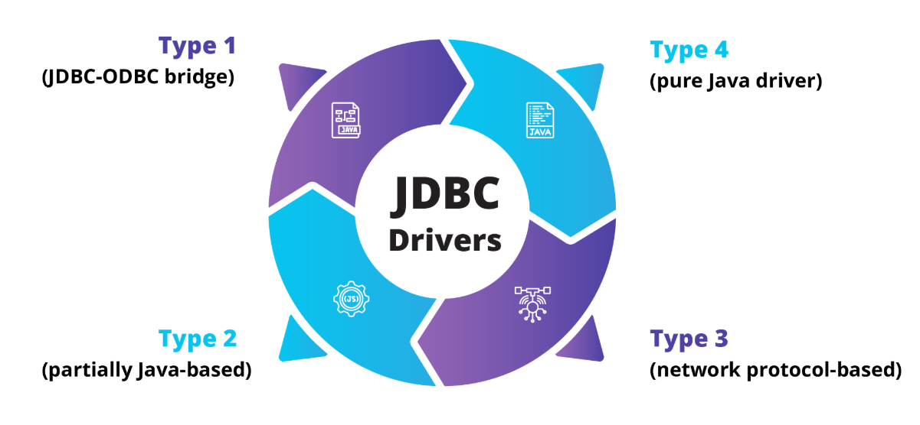
Core Technologies
CORE JAVA(8+) : Object-oriented programming, collections framework, exception handling, and multithreading capabilities.The use of classes (Flight, Passenger, Reservation) to model real-world entities.
Data Structures: The utilisation of standard Java collections like ArrayList, arrays (e.g., boolean[] for seat availability), and potentially HashMap.
JDBC: Database connectivity using DriverManager, PreparedStatements, and ResultSet for secure data operations..
MySQL Database: Relational database for storing flight details, passenger records, and booking transactions.
Backend Dependencies (Node.js + Express)
Core Dependencies
express – Web framework for Node.js
mongoose – MongoDB object modeling tool
dotenv – Loads environment variables from .env file
cors – Enables Cross-Origin Resource Sharing
nodemon – Auto-restarts server during development
🔐 Authentication & Security
bcryptjs or bcrypt – Password hashing
jsonwebtoken – Token-based authentication (JWT)
Additional/Optional
multer – For file uploads (PDFs, images, assignments)
cookie-parser – Parses cookies if needed for auth/session.
Frontend Dependencies (React)
Core Dependencies
react – JavaScript library for building UI
react-dom – Renders React elements to the DOM
react-router-dom – For client-side routing/navigation
axios – To make HTTP requests to the backend
🔐 Authentication & State Management
jwt-decode – To decode and manage JWT tokens
react-context or redux (optional) – For global state management (user auth, course data)
Styling & UI
TailwindCSS – For styling and responsive layout.
react-icons – To use icons across the UI

Slide 6
Key Features
Frontend Implementation (React.js) :
Pages: Signup/Login, Dashboard, Course List, Course Details.
Components: Navbar, Sidebar, Card, CourseTile.
State Management: useContext, useReducer
API Calls: Axios to Express API
Backend Implementation (Node.js + Express.js + MongoDB) :
Initialize the Project
Connect MongoDB
Set up Project Structure
Implement User Authentication
Course Management
File Uploads using multer.
Testing and Security
Passenger Registration
Capture passenger details with validation and store securely in database
Booking Management
Create, modify, and cancel reservations with automatic seat allocation.
Flight Management
Flight CRUD operations: create, view, update, and delete flights.
JDBC-Based Database Connectivity
Uses JDBC for SQL queries and MySQL interaction without any framework.

Slide 7
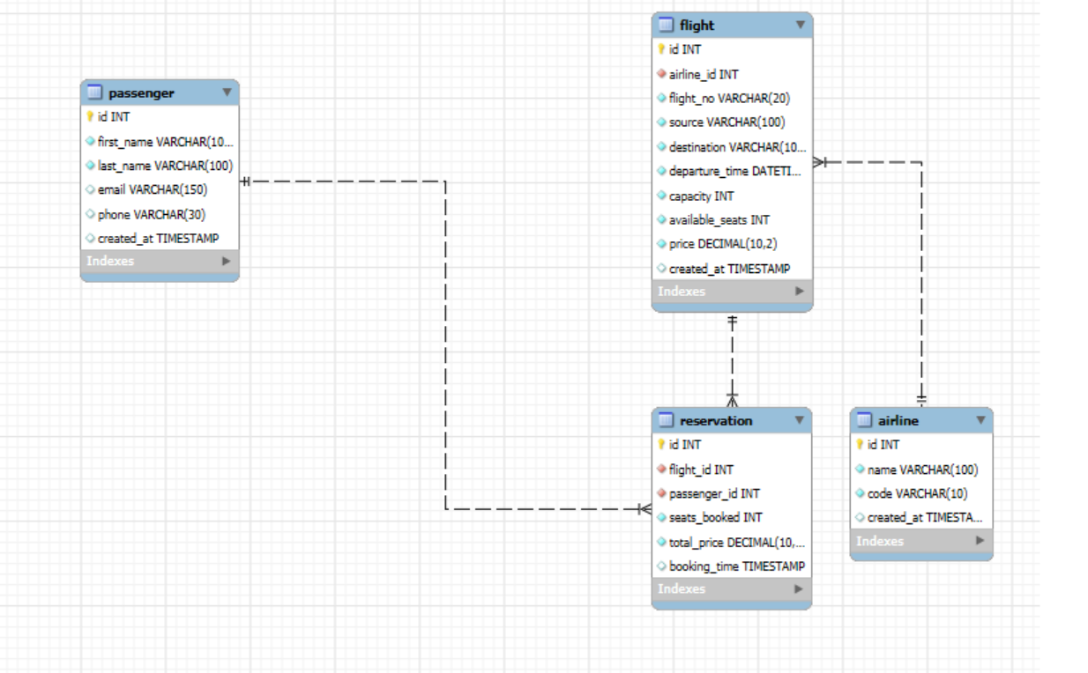
Database Schema
1. User Authentication and Authorization :
Secure login and registration using JWT (JSON Web Tokens) or similar methods.
Role-based access control (RBAC) for students, instructors, and administrators, ensuring users only access features relevant to their roles.
2. Course Management :
Creation, updating, and deletion of courses by instructors or admins.
Structured categorization of courses for easy navigation and discovery.
Upload and management of course materials (videos, PDFs, documents), often using cloud storage solutions
3. Content Delivery and Interactive Learning :
Dynamic presentation of course content using React.js for a responsive user experience
4. Responsive and Modern User Interface :
Intuitive, mobile-friendly design using React.js, ensuring accessibility and a seamless user experience across devices

Slide 8
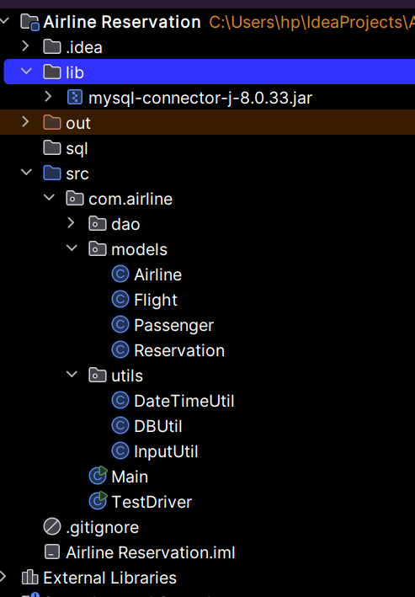
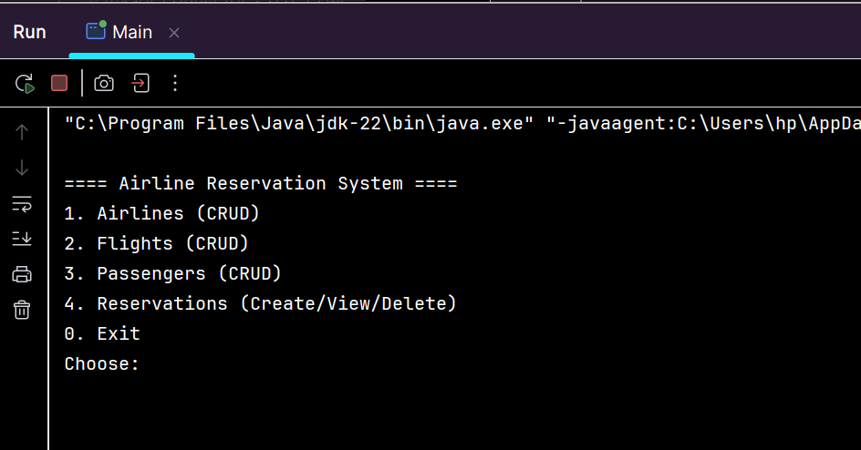

Project Screenshots
User Registration and Authentication : Secure sign-up and login via JWT-based authentication. Once a new user registers on the platform, there is a feature of otp verification in which an otp will be sent to his/her email account, after that, they can successfully register.
Profile Management: Ability for users to view and access their personal information.
Course Enrollment: Students can browse, search, and enroll in available courses.

Slide 9
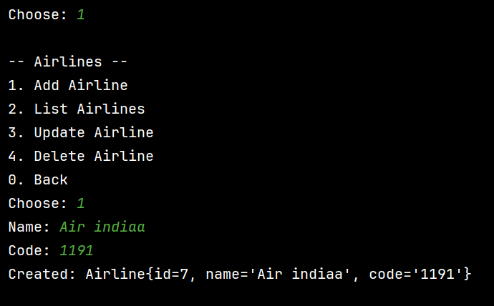

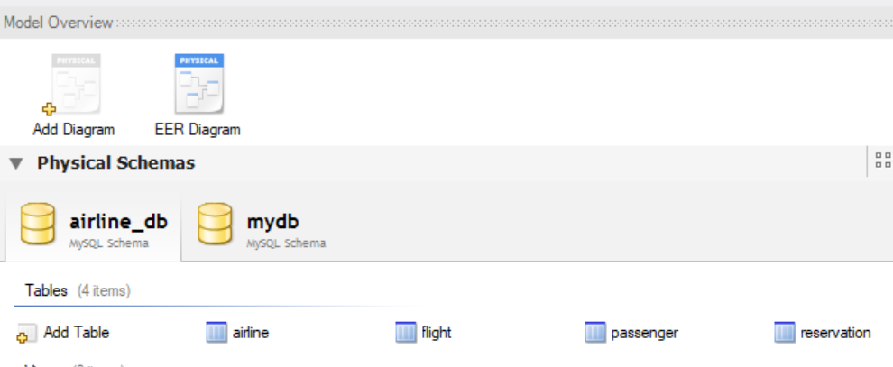
Dashboard and Analytics :
Centralized dashboard displaying platform-wide statistics such as total users, active courses, enrollment numbers, and engagement metrics
Course Management :
Full CRUD (Create, Read, Update, Delete) operations for user accounts, including adding, editing, or deleting students, instructors, and other admins.

Slide 10
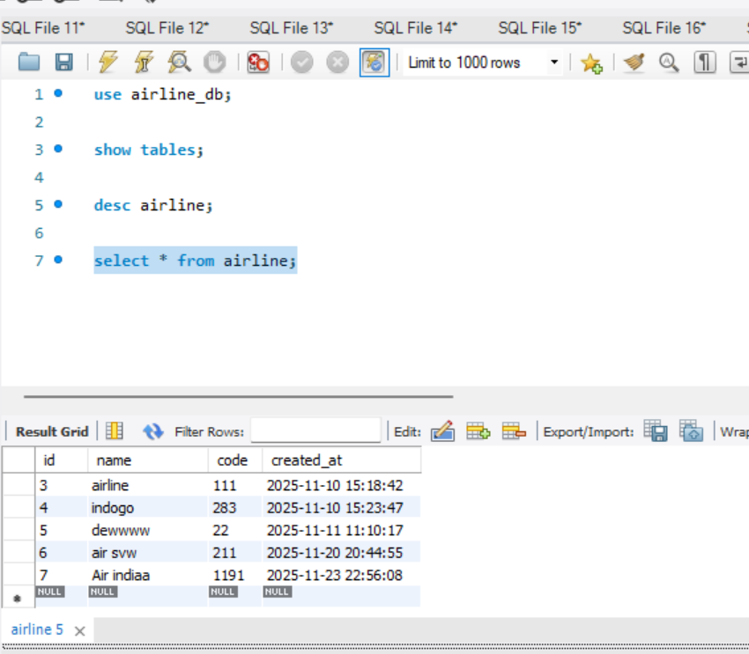
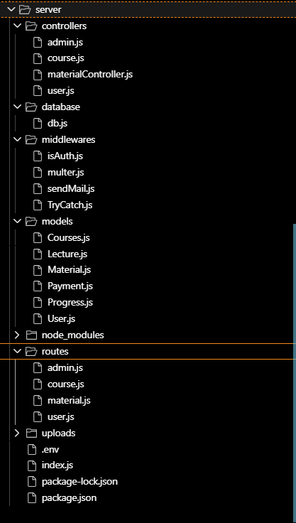
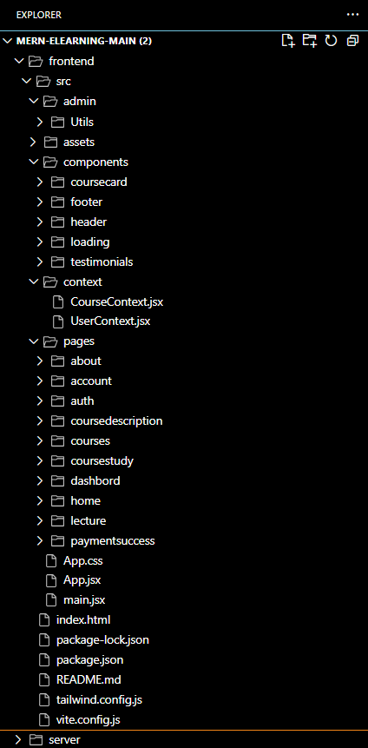
BACKEND
FRONTEND

Slide 11
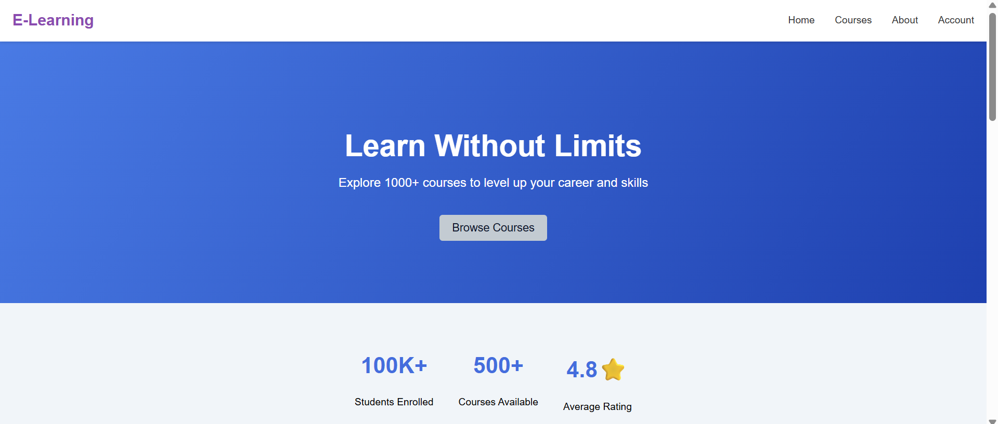
Future Scope
HOMEPAGE
Implementing Advanced Data Analytics and AI/ML: The next step is integrating artificial intelligence and machine learning models to analyse vast amounts of data.
Migrating to Cloud-Native Architecture: The system will move from traditional, monolithic architectures to scalable, cloud-native microservices platforms (e.g., using AWS, Azure, Google Cloud).
Enhancing Customer Experience with Modern Interfaces: This involves leveraging modern front-end frameworks (like React or Angular) to build intuitive mobile apps and websites, and incorporating AI-powered chatbots and voice assistants for instant customer support and booking assistance.

Slide 12
Conclusion
ABOUT PAGE :
The conclusion of a Java console-based airline reservation project is the successful creation of a functional, text-based reservation system that effectively applies fundamental programming concepts to simulate real-world operations.
Fundamentally, it serves as a robust demonstration of core object-oriented programming (OOP) principles, utilising classes like Flight, Passenger, and Booking, along with encapsulation and inheritance to create a structured and maintainable codebase.
Ultimately, the primary conclusion is the successful acquisition and application of core Java skills—such as loops, conditionals, file handling, and user input processing—providing a solid foundational stepping stone for developers to tackle future, more sophisticated projects involving databases, graphical user interfaces, or web-based technologies.

Slide 13
References
YouTube: https://youtu.be/AHFBPxWebFQ?si=1gpemxiVbB22aXkv
JetBrains: https://www.jetbrains.com/idea-edu/
Tutorials Point: https://www.tutorialspoint.com/intellij_idea/intellij_idea_create_first_java_project.htm
OneClick: https://www.oneclickitsolution.com/blog/airline-reservation-system

Slide 14
THANK YOU!

